Slide 1
Chapter 5
Boundary Value Testing

Slide 2
Functional Testing
The rationale for referring to specification-based testing as “functional testing” is likely due to the abstraction that any program can be viewed as a mapping from its Input Domain to its Output Range:
Output = F ( Input )
F
Domain
Range
Functional testing uses information about functional mappings
to identify test cases. We illustrate much of this with a function F of two variables, x₁ and x₂ . Extension to more variables is straightforward.

Slide 3
Mainline Spec-based Testing Techniques
Boundary Value Testing (4 flavors)
Equivalence Partitions (Chapter 6)
Special Value Testing
Output Domain (Range) Checking
Decision Table Based Testing, aka Cause and Effect Graphs (Chapter 7)

Slide 4
Boundary Value Testing
Two considerations apply to boundary value testing
  are invalid values an issue?
  can we make the “single fault assumption” of reliability theory?
Consequences...
  invalid values require the robust choice
  multiplicity of faults requires worst case testing
Taken together, these yield four variations
  Normal boundary value testing
  Robust boundary value testing
  Worst case boundary value testing
  Robust worst case boundary value testing

Slide 5
Rationale for Boundary Value Testing
Industrial, commercial, and defense software all note that faults seem to be more prevalent when variables have values at or near their extreme boundaries.
In the early 1990s, there was a commercial test tool, named simply “T”, that implemented boundary value testing.
T was originally requested by the U.S. Army
The product has been merged into
  Teamwork from Cadre Systems, and
  Software through Pictures from Aonix

Slide 6
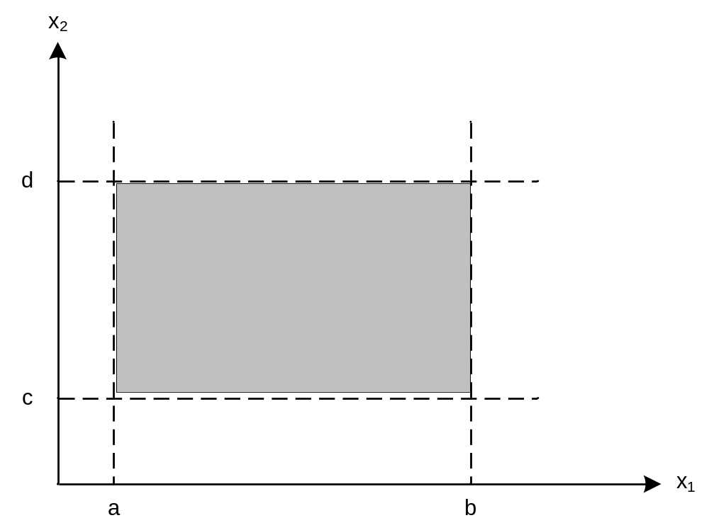
Input Domain of F(x₁, x₂)
where a ≤ x₁ ≤ b and c ≤ x₂ ≤ d

Slide 7
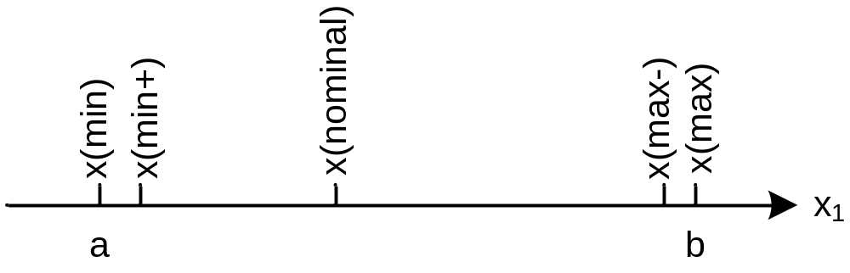
Input Boundary Value Testing
Test values for variable x, where
  a ≤ x₁ ≤ b, and
  x(min), x(min+), ... x(max) are the names from the T tool.

Slide 8
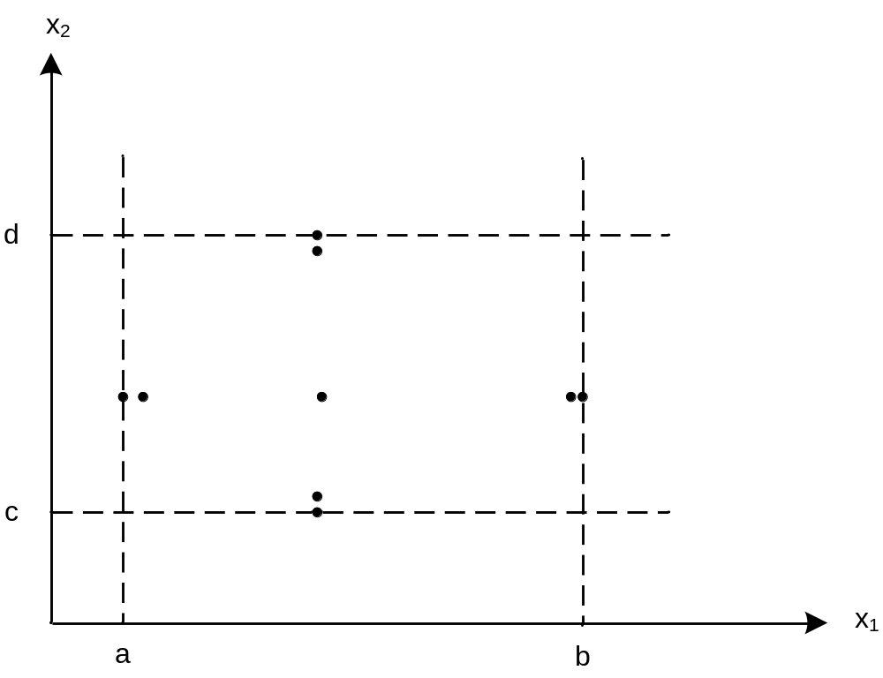
Normal Boundary Value Test Cases
As in reliability theory, two variables rarely both assume their extreme values.

Slide 9
Method
Hold all variables at their nominal values.
Let one variable assume its boundary values.
Repeat this for each variable.
This will (hopefully) reveal all faults that can be attributed to a single variable.
Exercise: why might this not work?

Slide 10
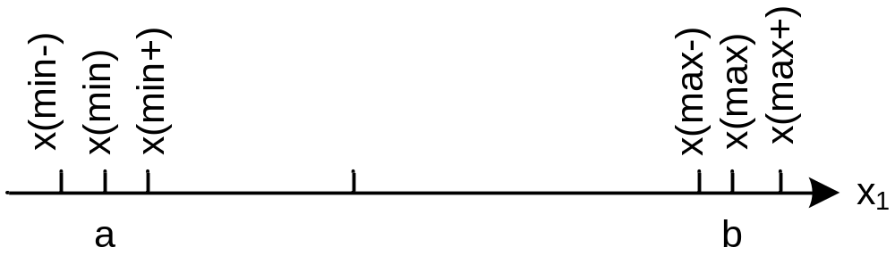
Robustness Testing
Stress boundaries
Possible advantages
  find hidden functionality
  leads to exploratory testing
But...
  what are the expected outputs?
  what if the programming language is strongly typed? (e.g., Ada)

Slide 11
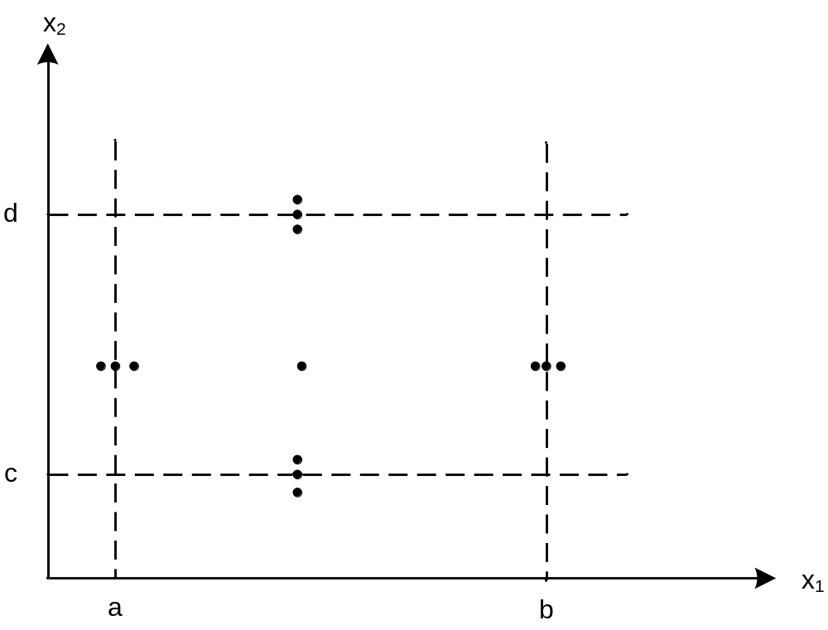
Robust Boundary Value Test Cases

Slide 12
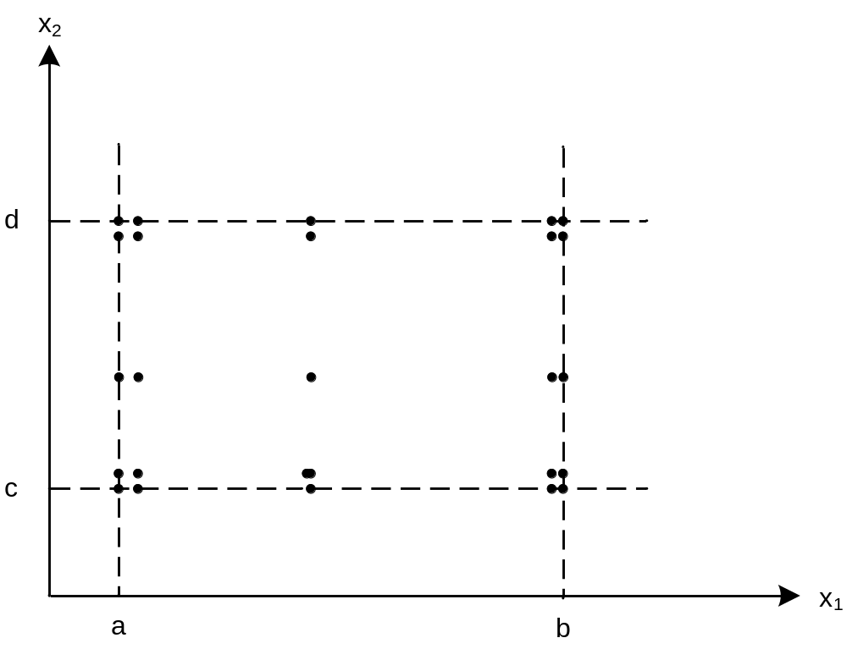
Normal Worst Case Boundary Value Test Cases
Responding to the single-fault assumption.

Slide 13
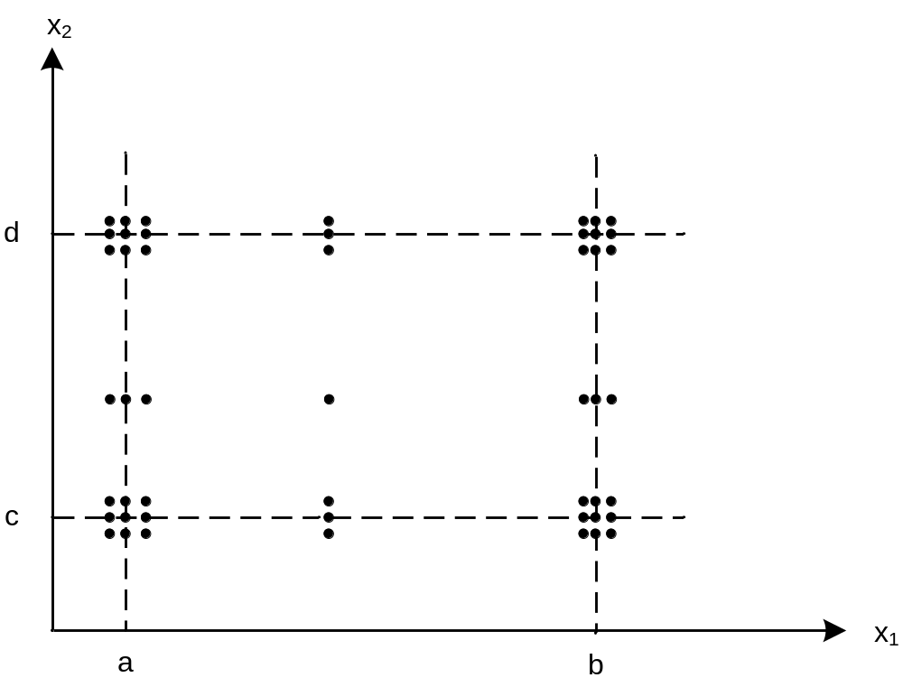
Robust Worst Case Boundary Value Test Cases

Slide 14
Special Value Testing
Appropriate for
  complex mathematical calculations
  worst case situations ( similar to robustness)
  problematic situations from past experience
Characterized by...
  "second guess" likely implementations
  experience helps
  frequently done by customer/user
  defies measurement
  highly intuitive
  seldom repeatable
  (and is often most effective)

Slide 15
Output Range Coverage
1. Work "backwards" from expected outputs
(assume that inputs cause outputs).
2. Mirror image of equivalence partitioning
(good cross check)
3. Helps identify ambiguous causes of outputs.

Slide 16
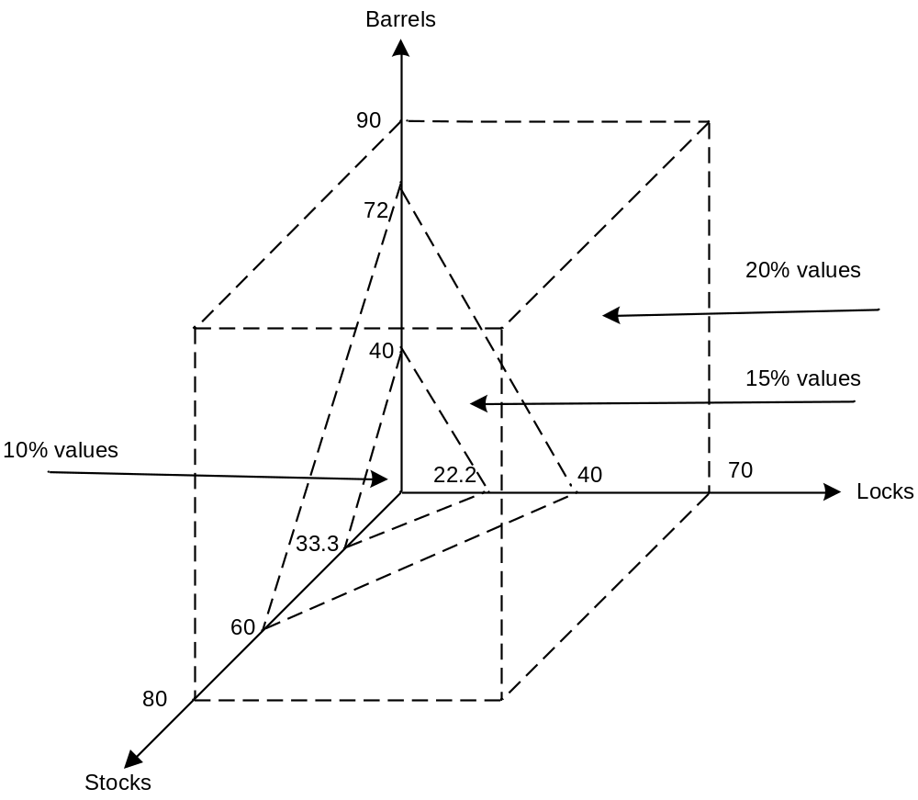
Input Domain for Commission Problem

Slide 17
NextDate Function
NEXTDATE is a function of three variables: month, day, and
year, for years from 1812 to 2012. It returns the date of the
next day.
NEXTDATE( Dec, 31, 1991) returns Jan 1 1992
NEXTDATE( Feb, 21, 1991) returns Feb 22 1991
NEXTDATE( Feb, 28, 1991) returns Mar 1 1991
NEXTDATE( Feb, 28, 1992) returns Feb 29 1992
Leap Year: Years divisible by 4 except for century years not
divisible by 400. Leap Years include 1992, 1996, 2000.
1900 was not be a leap year.

Slide 18
Boundary Value Test Cases for NextDate
Observations
  not much reason for robustness testing
  good reasons for worst case testing
Large number of test cases
  15 normal boundary value test cases
  125 worst case boundary value test cases
  (see text for test case values)
What problems do you see with the normal boundary value test cases on the next slide?

Slide 19
Boundary Value Test Cases for NextDate
Case | Month | Day | Year | Expected Output
1 | 1 | 1 | 1812 | 1, 2, 1812
2 | 1 | 1 | 1813 | 1, 2, 1813
3 | 1 | 1 | 1912 | 1, 2, 1912
4 | 1 | 1 | 2011 | 1, 2, 2011
5 | 1 | 1 | 2012 | 1, 2, 2012
6 | 1 | 2 | 1812 | 1, 3, 1812
7 | 1 | 2 | 1813 | 1, 3, 1813
8 | 1 | 2 | 1912 | 1, 3, 1912
9 | 1 | 2 | 2011 | 1, 3, 2011
10 | 1 | 2 | 2012 | 1, 3, 2012
11 | 1 | 15 | 1812 | 1, 16, 1812
12 | 1 | 15 | 1813 | 1, 16, 1813
13 | 1 | 15 | 1912 | 1, 16, 1912
14 | 1 | 15 | 2011 | 1, 16, 2011
15 | 1 | 15 | 2012 | 1, 16, 2012

Slide 20
Special Value Test Cases
Case | Month | Day | Year | Reason
SV-1 | 2 | 28 | 2012 | Feb. 28 in a leap year
SV-2 | 2 | 28 | 2013 | Feb. 28 in a common year
SV-3 | 2 | 29 | 2012 | Leap day in a leap year
SV-4 | 2 | 29 | 2000 | Leap day in 2000
SV-5 | 2 | 28 | 1900 | Feb. 28 in 1900
SV-6 | 12 | 31 | 2011 | End of year
SV-7 | 10 | 31 | 2012 | End of 31-day month
SV-8 | 11 | 30 | 2012 | End of 30-day month
SV-9 | 12 | 31 | 2012 | Last day of defined interval

Slide 21
Output Range Test Cases
In the case of the NextDate function, the range
and domain are identical except for one day .
Nothing interesting will be learned from output
range test cases for this example.
Part of the reason for this is that the NextDate
function is a one-to-one mapping from its
domain onto its range. When functions are
not one-to-one, output range test cases are
more useful.

Slide 22
Pros and Cons of Boundary Value Testing
Advantages
  Commercial tool support available
  Easy to do/automate
  Appropriate for calculation-intensive applications with variables that represent physical quantities (e.g., have units, such as meters, degrees, kilograms)
Disadvantages
  Inevitable potential for both gaps and redundancies
  The gaps and redundancies can never be identified (specification-based)
  Does not scale up well (Jorgensen’s Law)
  Tools only generate inputs, user must generate expected outputs.

